Slide 1
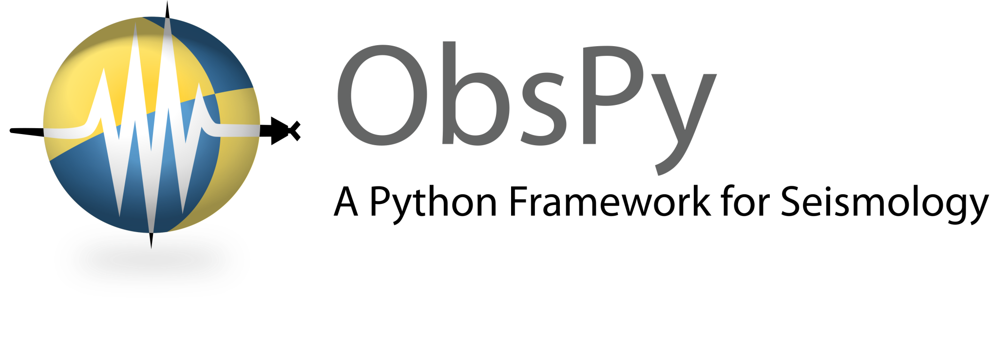
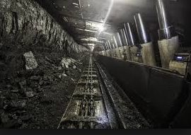
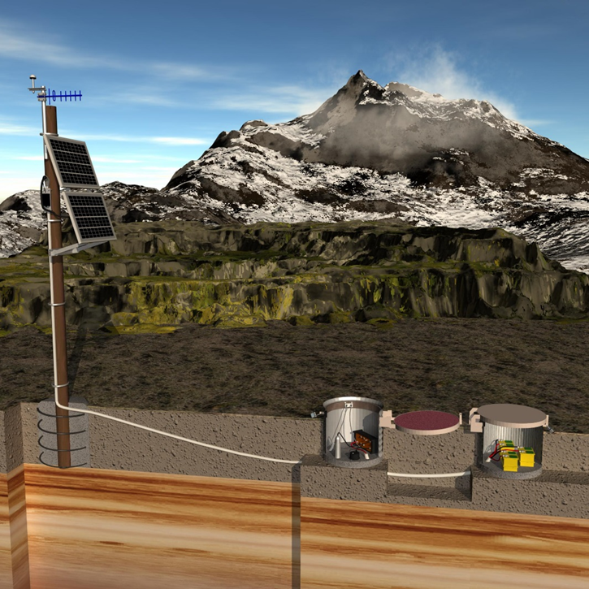
Pictures, Advice, and Earthquakes

Slide 2
Outline
Pictures
My background
Advice
Getting started with python
Concepts / packages to be aware of
Earthquakes
Analysis of an earthquake catalog
Basic usage of Pandas

Slide 3
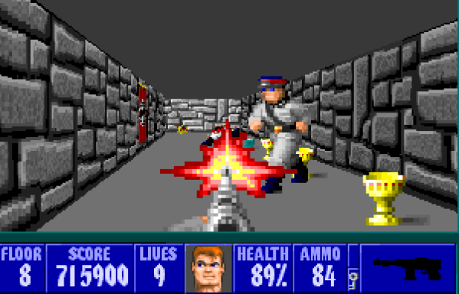


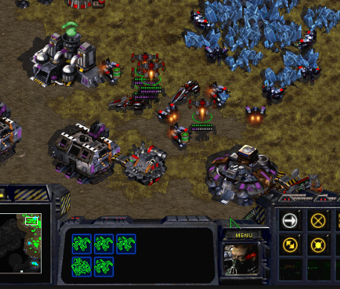

Slide 4
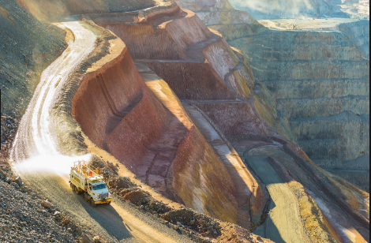

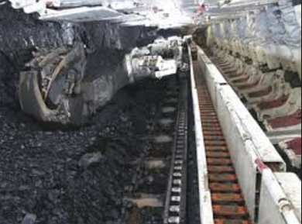
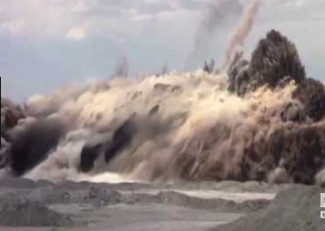

Slide 5
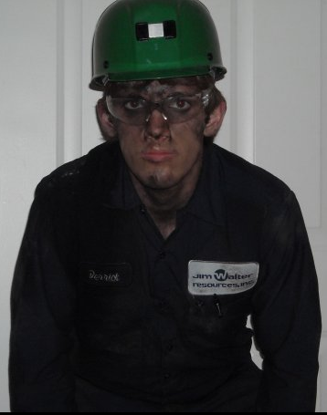
“One day you'll realize there's more to life than culture! There's dirt, and smoke, and good honest sweat!”
- Eric Idle

Slide 6
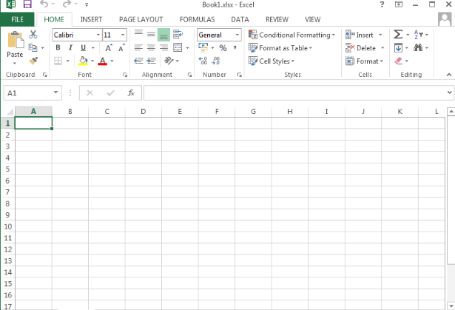

Slide 7
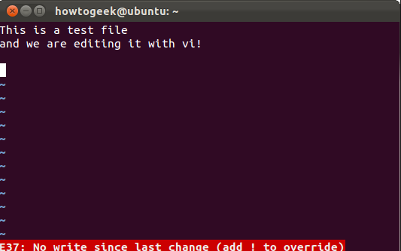
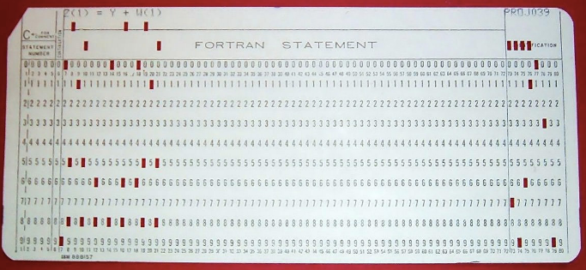

Slide 8
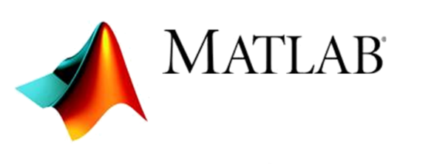
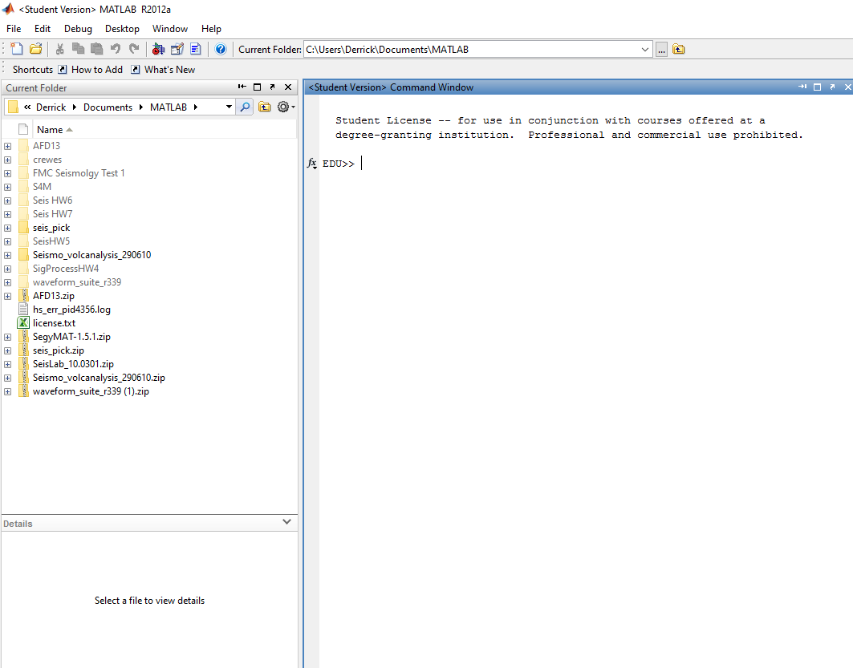

Slide 9




Slide 10
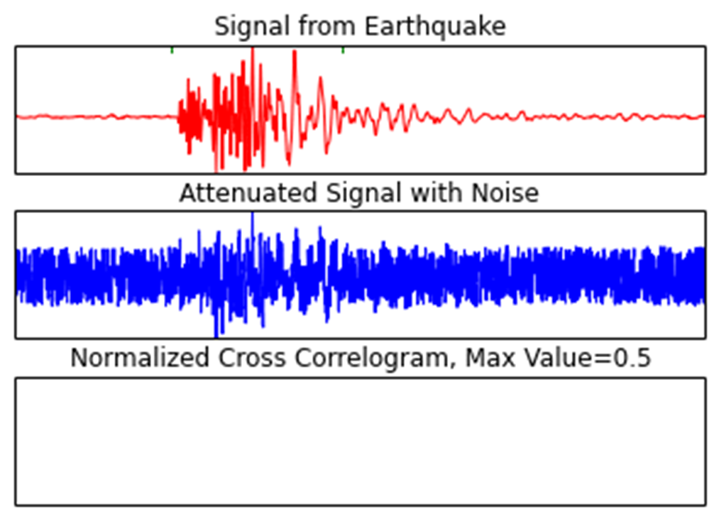

Slide 11
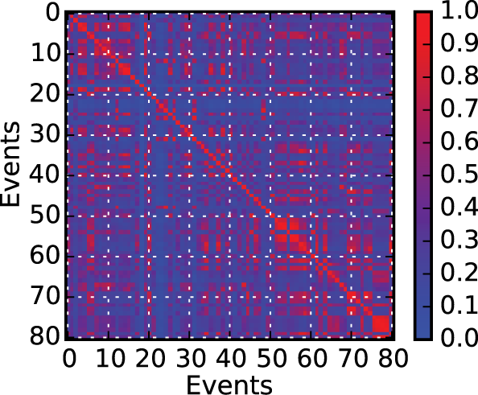
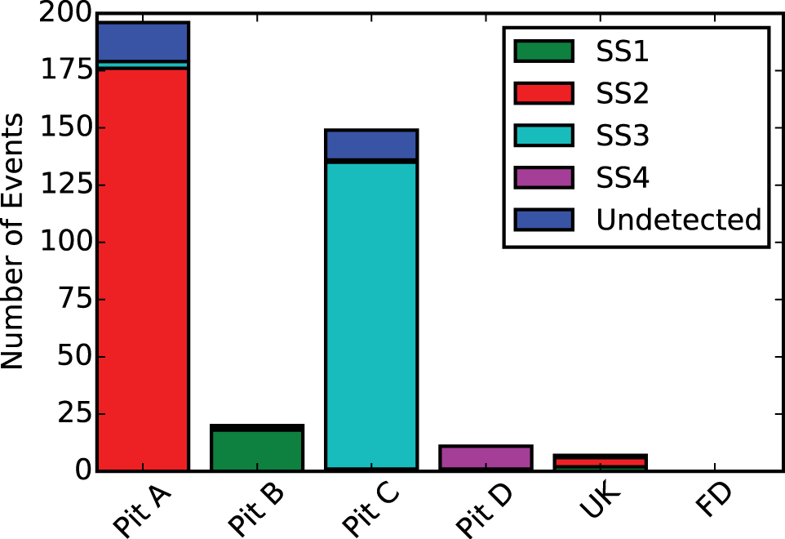
Detex
Waveform similarity clustering
Subspace detection (and waveform correlation)
Event association
Various visualization options

Slide 12
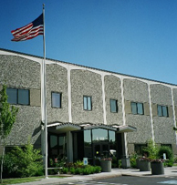

NIOSH Mining Research Program
Research seeks to work with industry and other collaborators to eliminate occupational diseases, injuries, and fatalities from the mining workplace
Research facilities in Spokane, WA and Pittsburgh, PA
Spokane Mining Research Division (SMRD)
Focus on western USA mining health and safety
Ground Control, Induced Seismicity, Automation Technology, and Miner Health teams
42 people split between the four groups

Slide 13
Advice to beginners
Downloading python
Development environments
Style guides
Version control
Testing
Documentation
Books / podcasts
Come up with a project
Open source contributions

Slide 14

Anaconda: the easy way to get python
https://www.continuum.io/downloads
Supports all major platforms
Free and open-source
Comes with many scientific package binaries (error: Unable to find vcvarsall.bat)
Supports Python, R, and Scala
Has virtual environments and dependency management

Slide 15
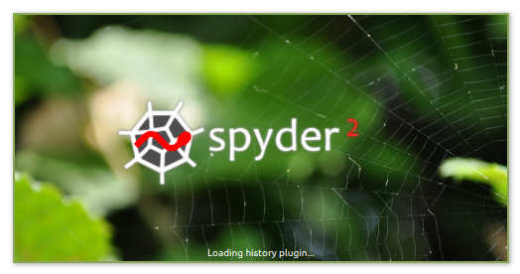
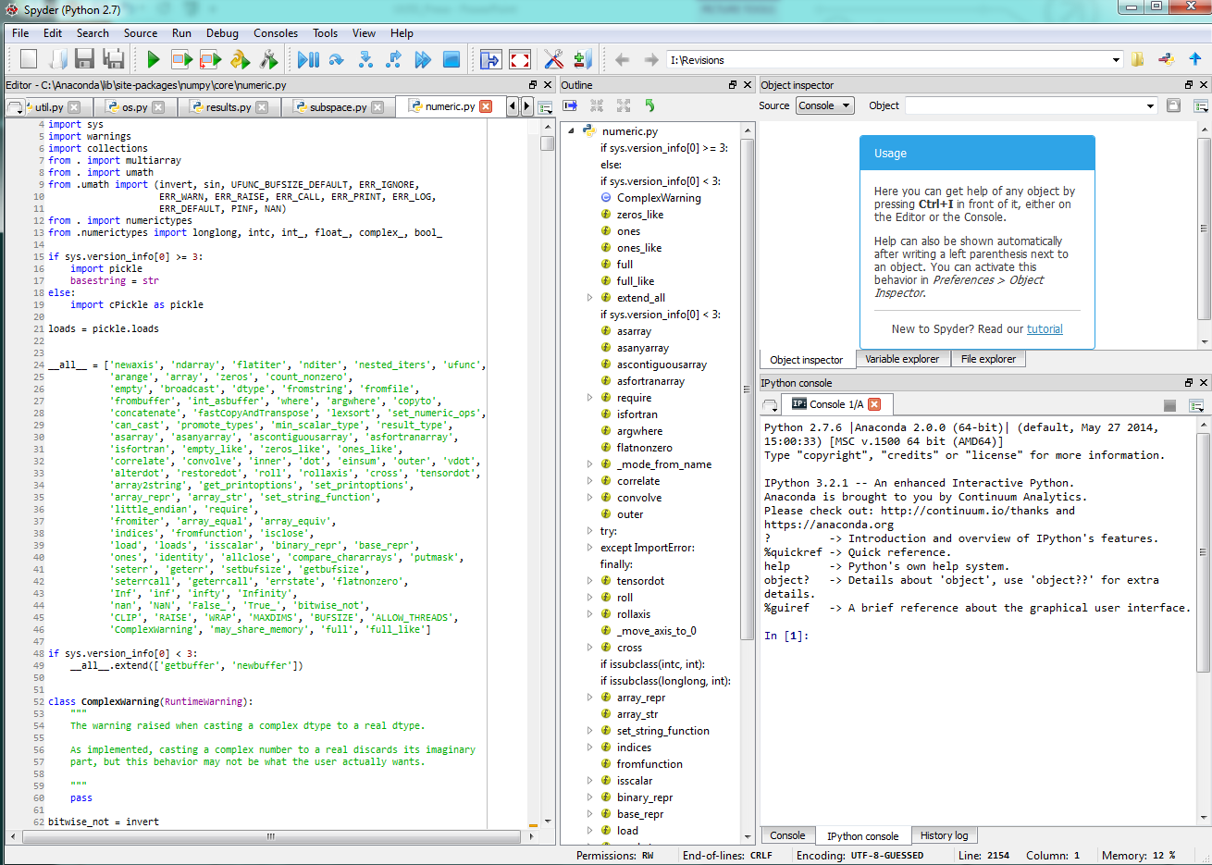
Developing in Python : Spyder
Real time syntax and style highlighting
Breakpoints for debugging
Embedded ipython consoles
Break points for
Similar to matlab

Slide 16

Developing in Python : Pycharm
Integration with testing frameworks and version control systems
Refactoring tools
Customizable hotkeys
Integrated debugger (including remote processes)
Free community edition
Everything you need, and then a lot more

Slide 17

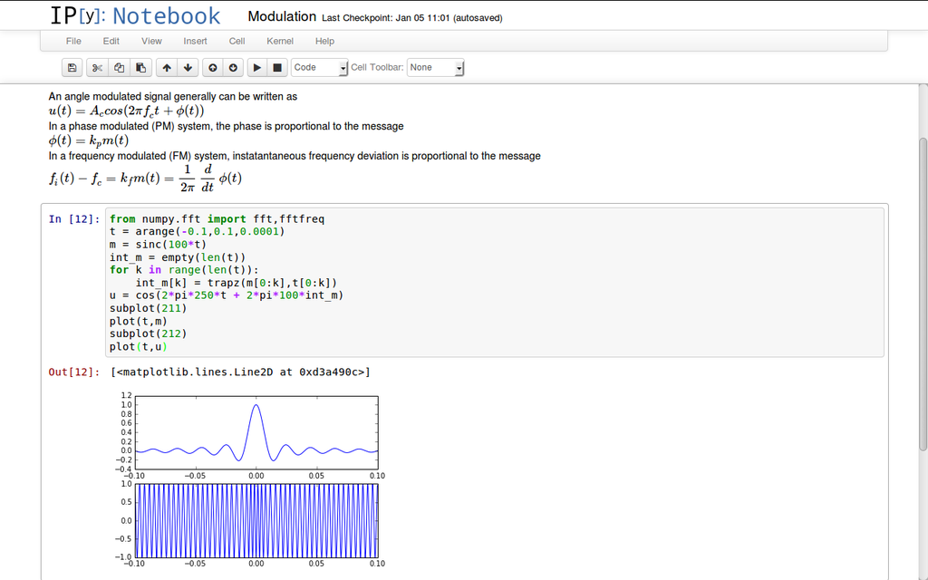
Sharing Your Work : Jupyter Notebook
Web based interactive environment that supports code, text, images, equations, etc.
Easy to share your work for reproducible analysis
Supports interactive widgets
To open :
>>> jupyter notebook

Slide 18
Style Guide : Pep 8
https://www.python.org/dev/peps/pep-0008/
Makes your code more readable (most of the time)
Makes your code more creditable
Not hard to learn (just enable style inspection)
Google “beyond pep8” (talk by Raymond Hettinger)

Slide 19
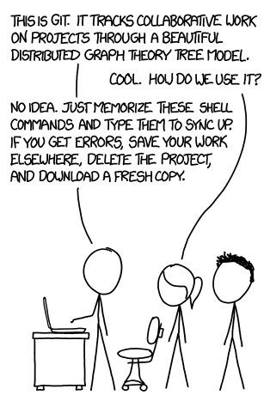
Version Control : Git
Version control is very important!
Git is the most widely used (github)
Spend time learning the basics

Slide 20
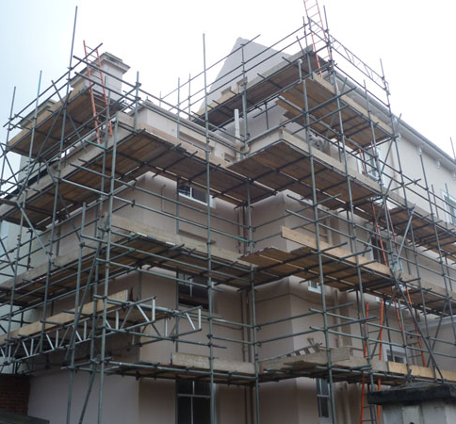
Testing
Automated tests help support your code
A bug fix is accompanied with a test
Tests can (and should) be written as you develop
A good test suite helps ensure correctness and detect regressions
Over testing can end up costing time and make refactoring hard

Slide 21
Testing : When?
Is this code script or package? (Don’t let it turn into “scrappage”)
Will someone else run this code?
Are you using more than a few external libraries?

Slide 22
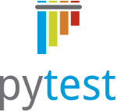
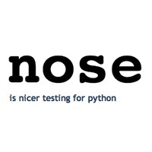
Testing : Python Frameworks
Unittest
included in standard library
Nose
Pytest
More pythonic
Requires less code
Customizable
Steep learning curve
In active development

Slide 23
Documentation
Document every public object with doc strings (doesn’t start with _)
For packages, create an informative readme
For medium to large projects, use a documentation tool (eg sphix)

Slide 24
Recommended Books
Python Crash Course
How to Think Like a Computer Scientist
Data Wrangling with Python
Fluent Python
Effective Python
Data Science from Scratch
Grokking Algorithms
Python Machine Learning

Slide 25

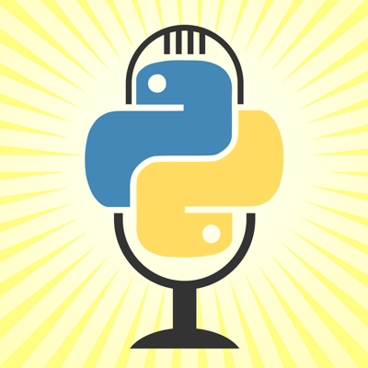
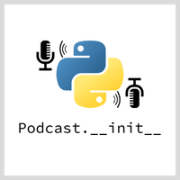
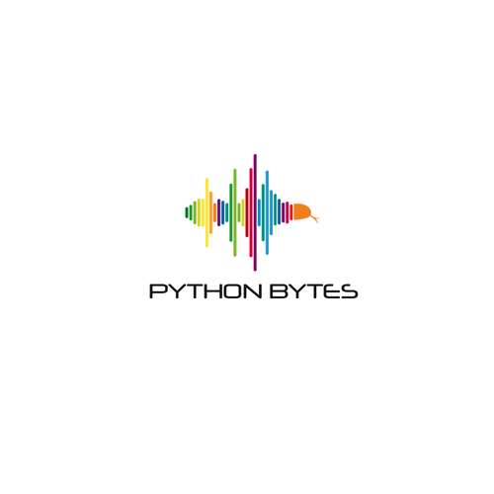
Recommended Podcasts
Talk Python to Me
Podcast.__init__
Python bytes
Partially Derivative
Test and code
Import This
The Python Experience

Slide 26
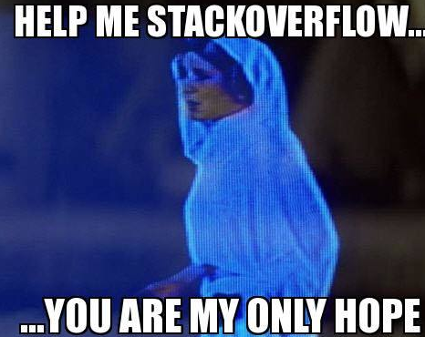
Work on Your Own Project
Identify a project you are interested in, or have to do for school/work, that can be done in python
Google “how to … in python”
Read more about topics that interest you

Slide 27
Open-Source Contribution
Best way to go from novice to pro
Find a project you like/use on github
Set a few hours aside to make a contribution
Improve documentation (elaborate, fix typos)
Find an issue (sometimes marked by difficulty) and try to resolve it
Python communities are very welcoming, don’t be afraid to try!

Slide 28
Important Packages
Foundation:
Numpy
Scipy
Matplotlib
Pandas (xarray)
Machine Learning:
Scikit-learn
Tensor Flow
Theano

Slide 29
Important Packages
Visualization:
Matplotlib
Seaborn
Bokeh
Ggplot
Basemap
Speed ups:
Cython
Numba

